Slide 1


CamWord
PRESENTED BY:- GUIDED BY:-
Hardik Patel (110370131055) Ms. Riddhi Patel
Kishan Patel (110370131070) Asst. Prof CSE Dept.
Zoeb Chhatriwala (110370131065) P.I.E.T

Slide 2
Project Profile
Title: “CamWord”
Description : To develop an Android Application that Translate (only in OCR) or Define a text on user selection. The text is either obtained through OCR or Speech Recognition. There is also an additional functionality that checks for word (user entered through android keyboard) spelling.

Slide 3
Contents
1. Abstract
2. Introduction
3. System Design Diagram
4. Tool Used
5. Advantages And Limitations
6. Future Work And Conclusion
7. References

Slide 4
Abstract
Our project is an Artificial Intelligence based application that uses character and speech recognition to identify word and define or translate (Only in OCR) on user request. This will save time of the user which he/she waste in typing and provide user with enhanced experience of smartphones technology.
Our project is developed in Android Programming Language and its features Character recognition and Speech recognition uses specific functional engines to obtain output. Our application can be used to identify a word from a document or a user voice.

Slide 5
Introduction
This application will provide three modules namely:
Character Recognition, Speech Recognition and Spell Check functionality.
Character Recognition module uses camera to detect word and give text output and we can also translate text.
Speech Recognition module uses microphone to detect voice and then translate it to text and we can translate and define word using dictionary.
Spell Check module uses the text(i.e. output) and perform the spell check using 3rd party(such as Google) to provide output.

Slide 6
Purpose
The Purpose of this system is to provide an integrated solution to the customer.
System Include:
1. Character Recognition
2. Speech Recognition
3. Spell Check functionality

Slide 7
Scope
Integration: Three different application or module is integrated into one fine app.
Fast to Use: As this application saves user time by character recognized and speech recognized word identification.
Accessibility: In this application, User can easily access functionalities of application and naïve user can also easily learn how to use.

Slide 8
Modular Description
Character Recognition: Word is recognized form the image capture from camera. This word is defined or translated based on user preference.
Speech Recognition: After activating this module user can just speak the word whose definition user want after doing predefined activating activity. The module will provide the definition of the word in a toast message.
Spell Check: This is a Module that checks the user word spelling and correct it.

Slide 9
Objective
The main objective of this application is to save the time of the user as typing a word every time is annoying task. Also the objective of this application is to give comfort and at ease to user.

Slide 10
Tools and Technology
Tesseract API:
Tesseract API (Application Programming Interface) which implements Tesseract engine for OCR (Optical Character Recognition).
Speech Recognition API:
Speech Recognition API is an API (Application Programming Interface) which implements Speech Recognition engine.

Slide 11
Eclipse IDE:
Eclipse is a multi-language Integrated development environment (IDE) comprising a base workspace and an extensible plug-in system for customizing the environment. It is written mostly in Java. It can be used to develop applications in Java and, by means of various plug-ins, other programming languages Development environments include the Eclipse Java development tools (JDT) for Java and Eclipse PDT for PHP, among others.
Eclipse SDK is free and open source software. It was one of the first IDEs to run under GNU Class path and it runs without problems under IcedTea.

Slide 12
Use Case Diagram

Slide 13
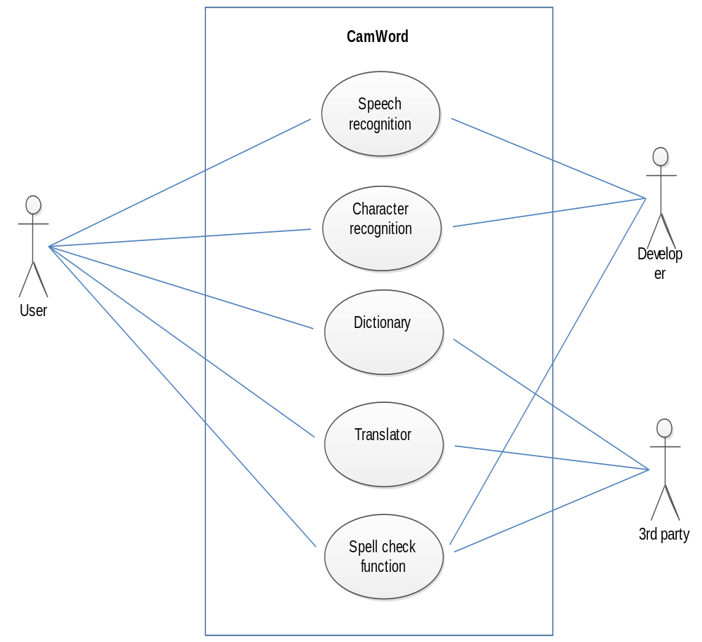

Slide 14
Sequence Diagram

Slide 15
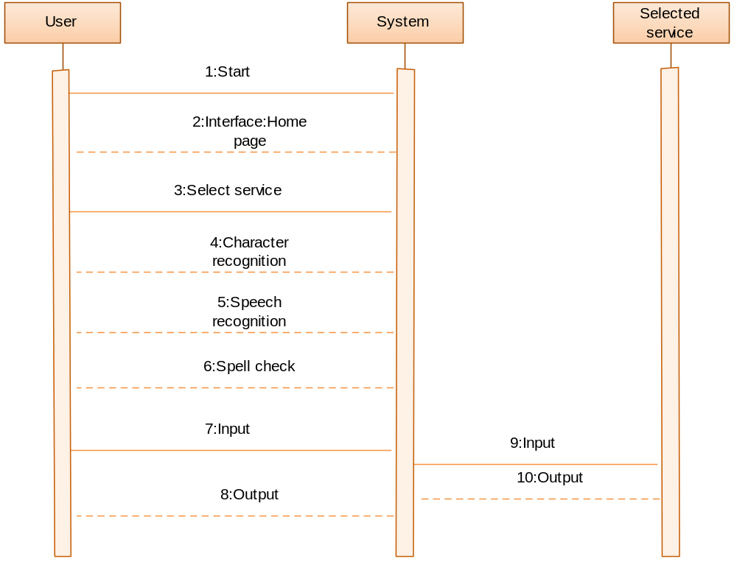

Slide 16
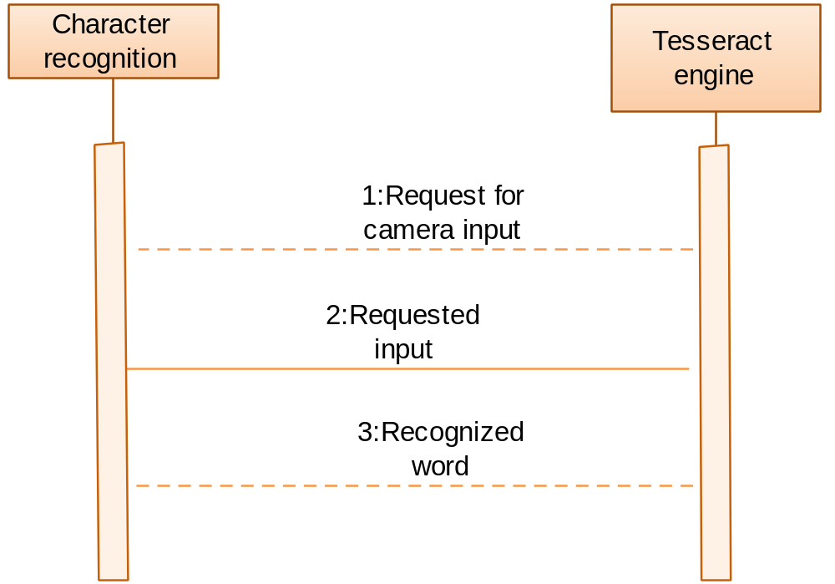

Slide 17
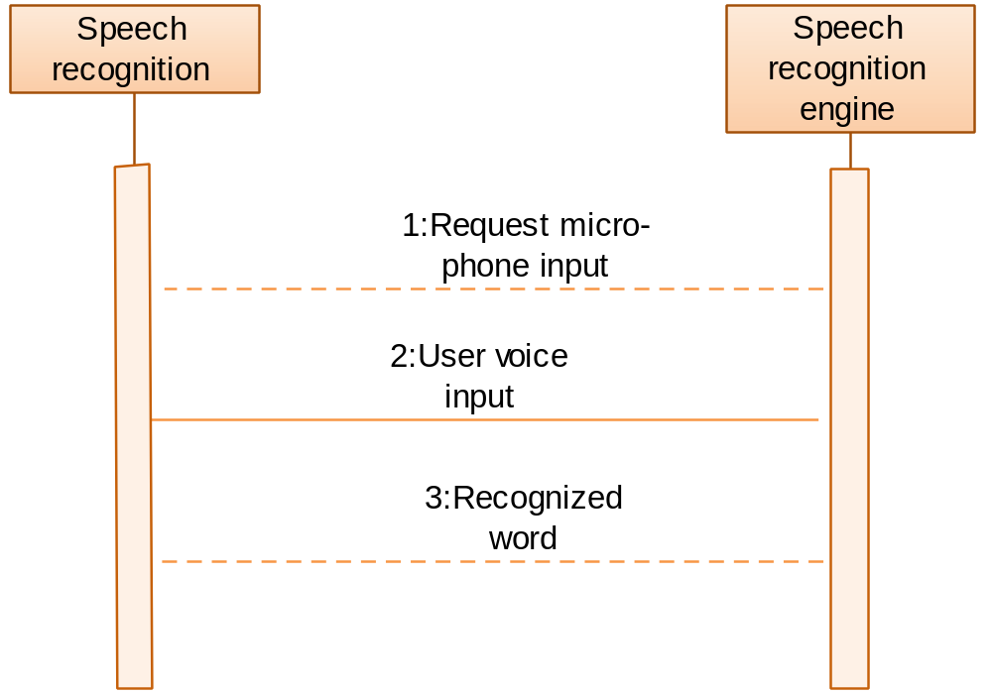

Slide 18
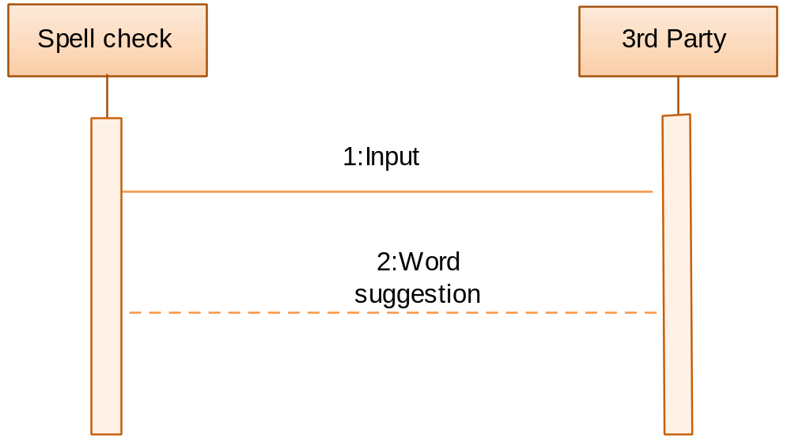

Slide 19
Entity Relationship Diagram

Slide 20
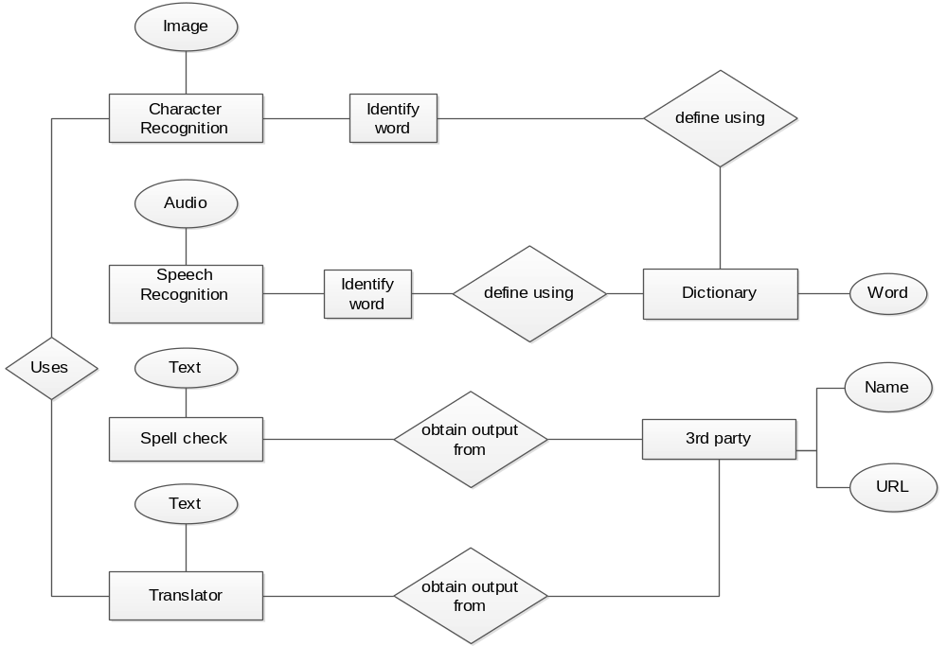

Slide 21
Class Diagram

Slide 22
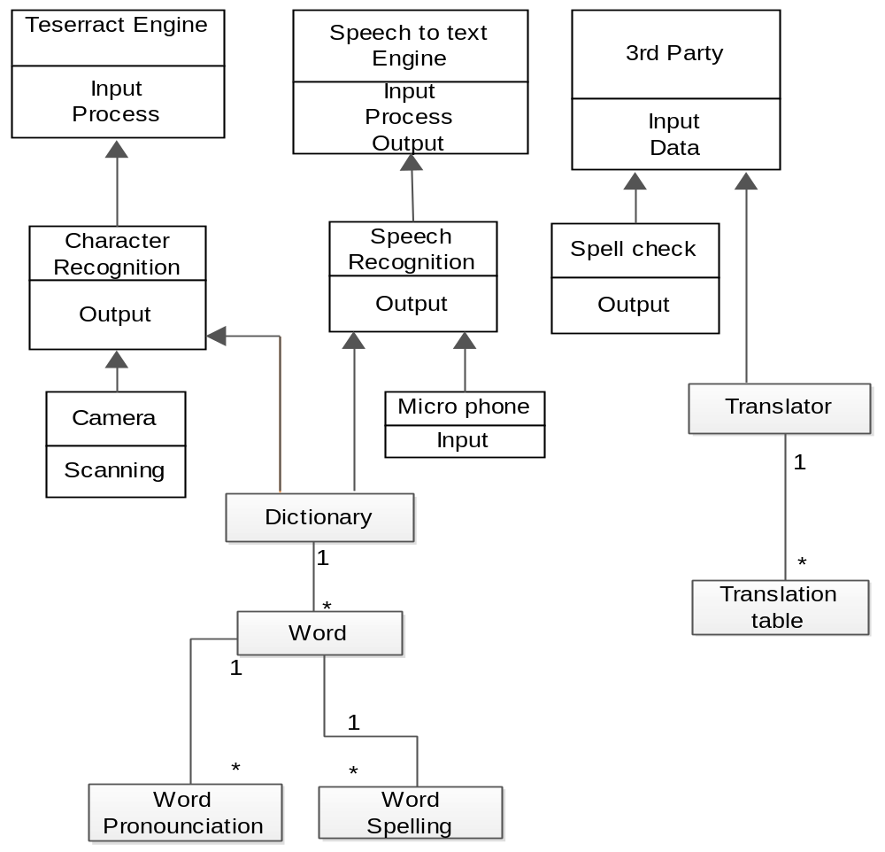

Slide 23
Activity Diagram

Slide 24
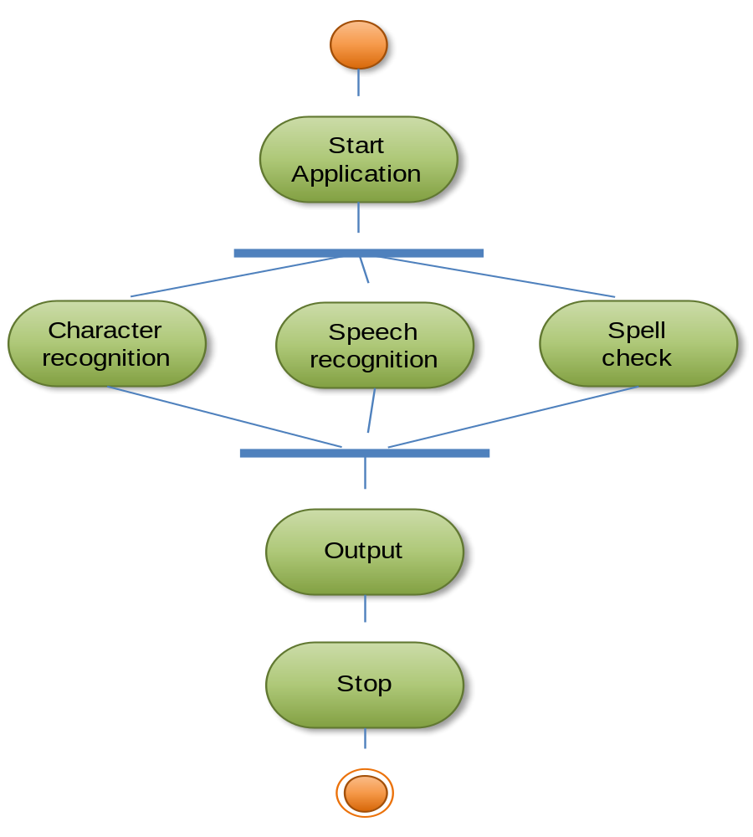
System

Slide 25
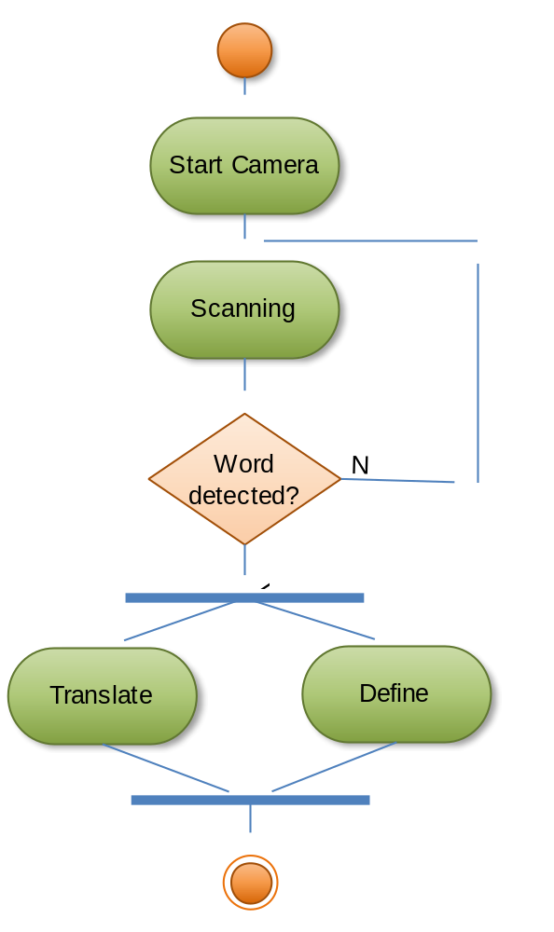
Character Recognition

Slide 26
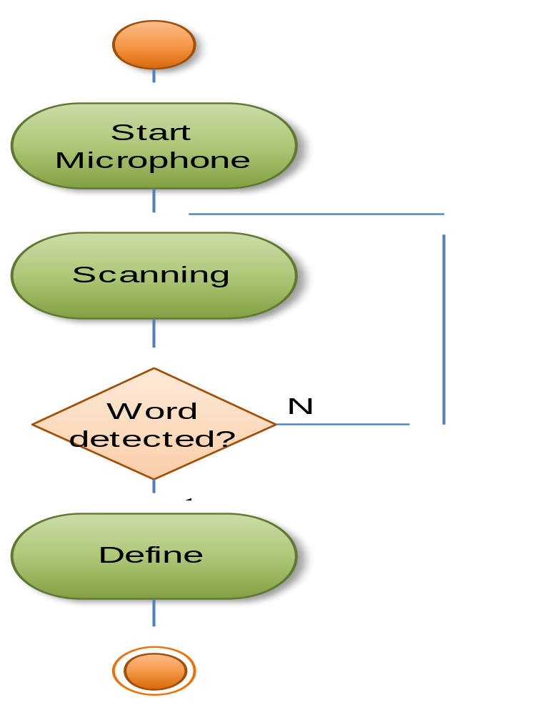
Speech Recognition

Slide 27
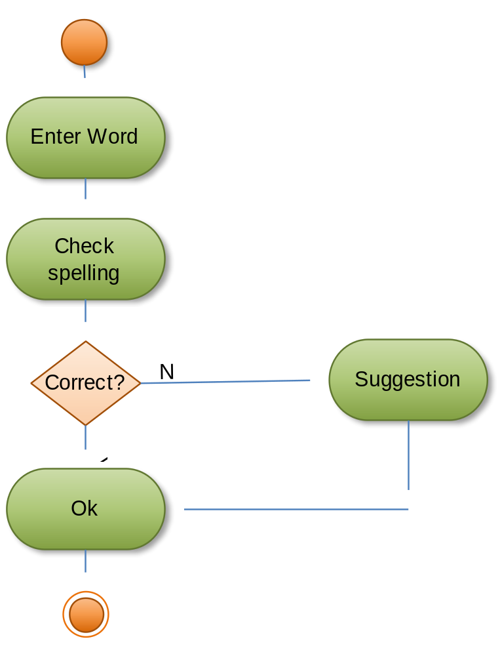
Spell Check

Slide 28
GUI Snapshots

Slide 29
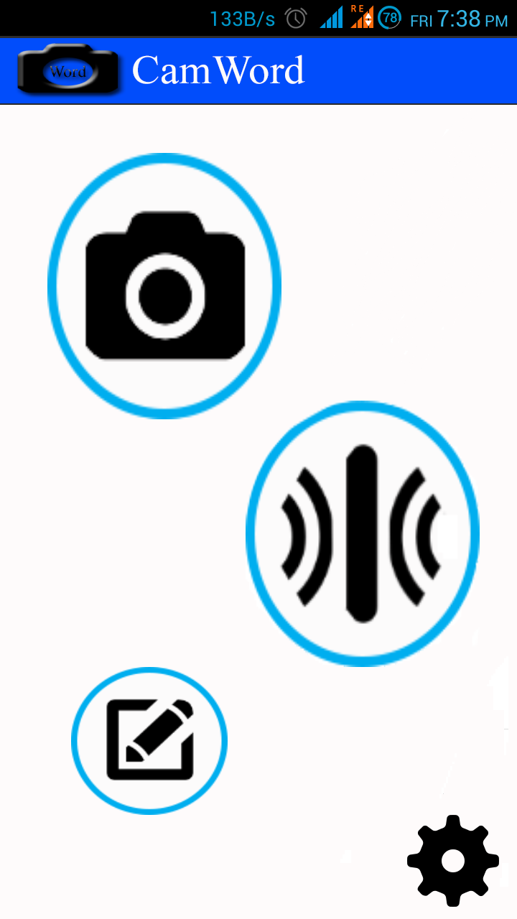

Slide 30
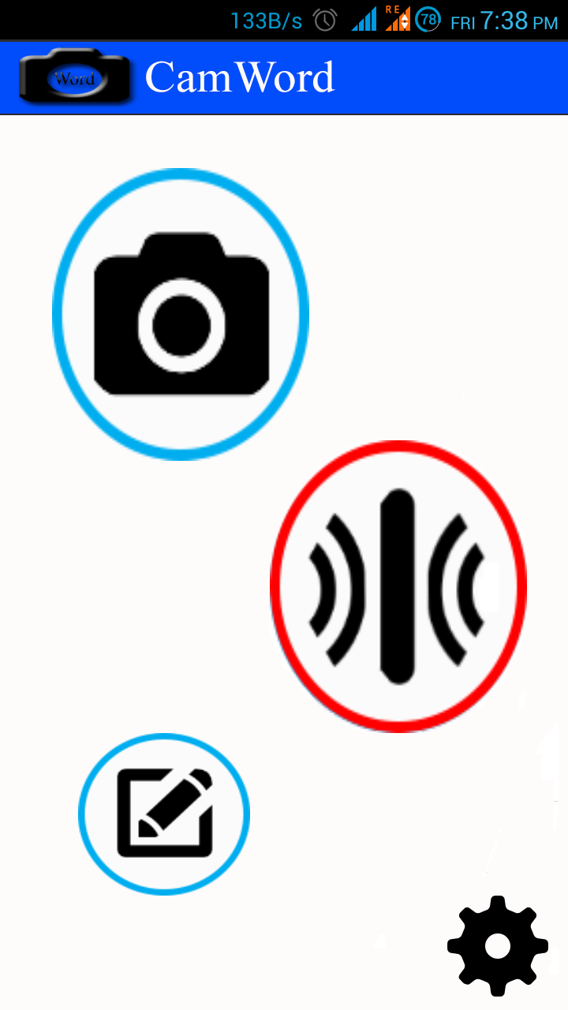

Slide 31
Description :
This is a home page of CamWord application.
Any user can use this application for it’s own purpose.

Slide 32
Advantages
Integration of three modules(i.e. Character, Speech recognition & Spell check).
User-friendly Graphical User Interface.
No need to type word as Character recognition and Speech recognition modules detect word with the help of camera and microphone respectively.
Easy to use.
Dictionary is provided to get the meaning of word.
Translation is provided to translate word.

Slide 33
Limitation
Camera with auto-focus is required to properly detect word from images.
Properly Working Mic is required for speech recognition.
Internet connection is required as translation is done with the help of 3rd party.

Slide 34
Future Enhancement
1. Development of application for different platforms.
2. Different Language addition for Character Recognition.
3. Different Language addition for Speech Recognition.
4. Different Language addition for Spell Checking.
5. Increase efficiency.

Slide 35
Conclusion
Thus by implementing this application it can be concluded that with the help of Character recognition and Speech recognition module user is able to translate word into text from image and voice respectively.
As user can also check the spelling and meaning of word with help of dictionary and also able to translate the word with the help of 3rd party(i.e. Google).

Slide 36
Reference
http://developer.android.com/guide/topics/fundamentals.html
http://www.Wikipedia.org
https://tesseract-ocr.googlecode.com/files/TesseractOSCON.pdf

Slide 37



